Slide 1

Moving Past A Global Pandemic
Aneesh Kapoor
Data 606 Capstone Project
Spring 2021

Slide 2
Phase 2
Data Cleaning and Preparation
Exploratory Data Analysis
Regression Testing

Slide 3
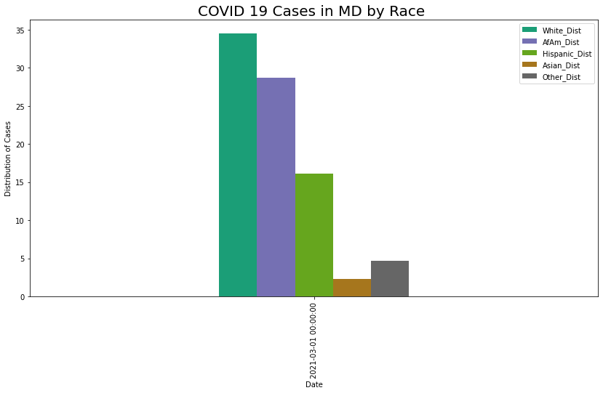
Exploratory Data Analysis

Slide 4
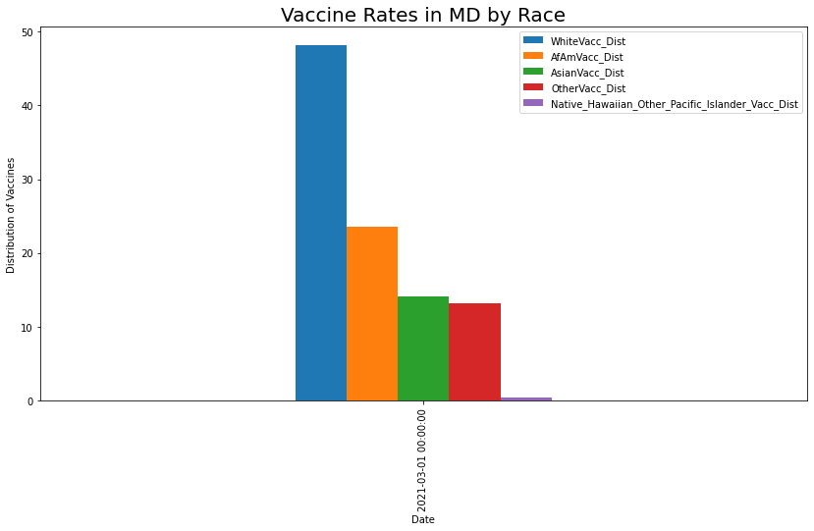
Exploratory Data Analysis

Slide 5
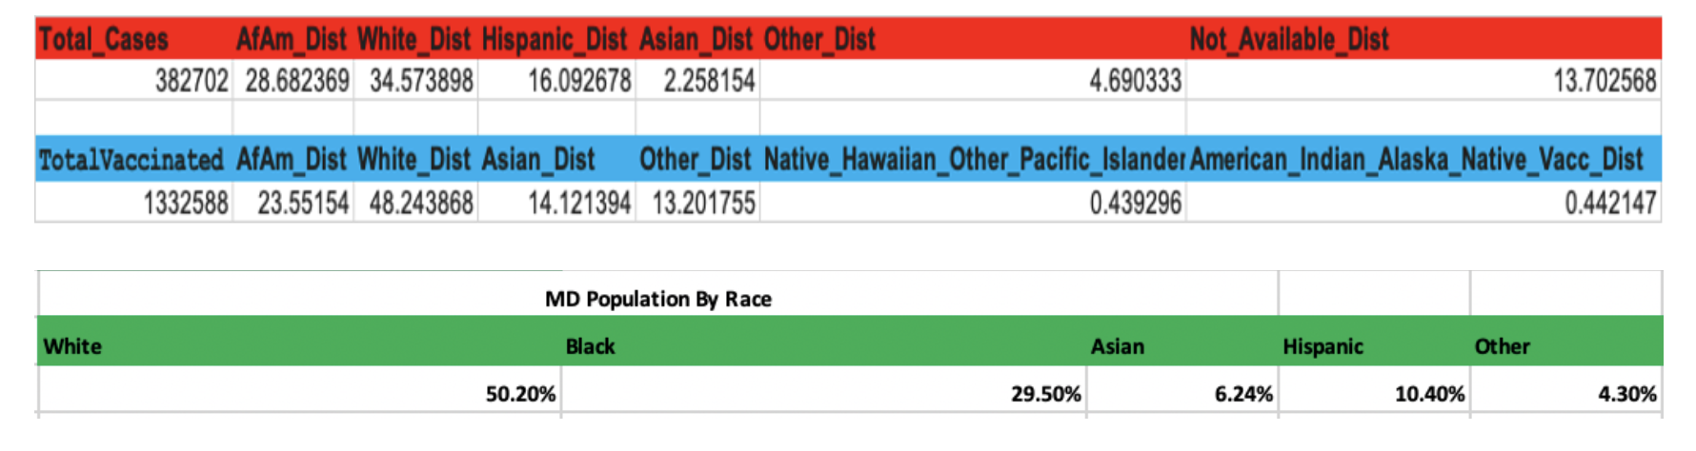
Exploratory Data Analysis

Slide 6
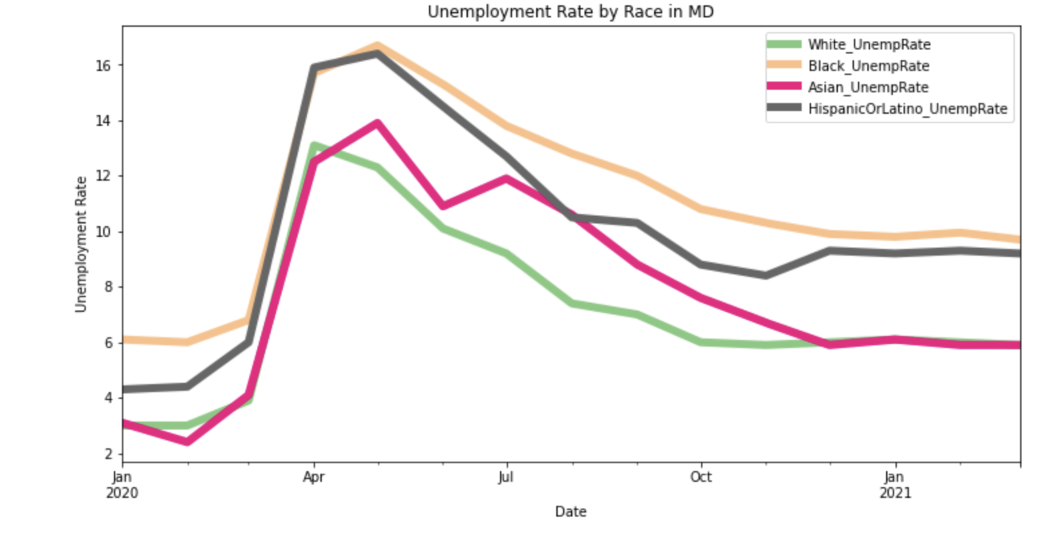
Unemployment

Slide 7
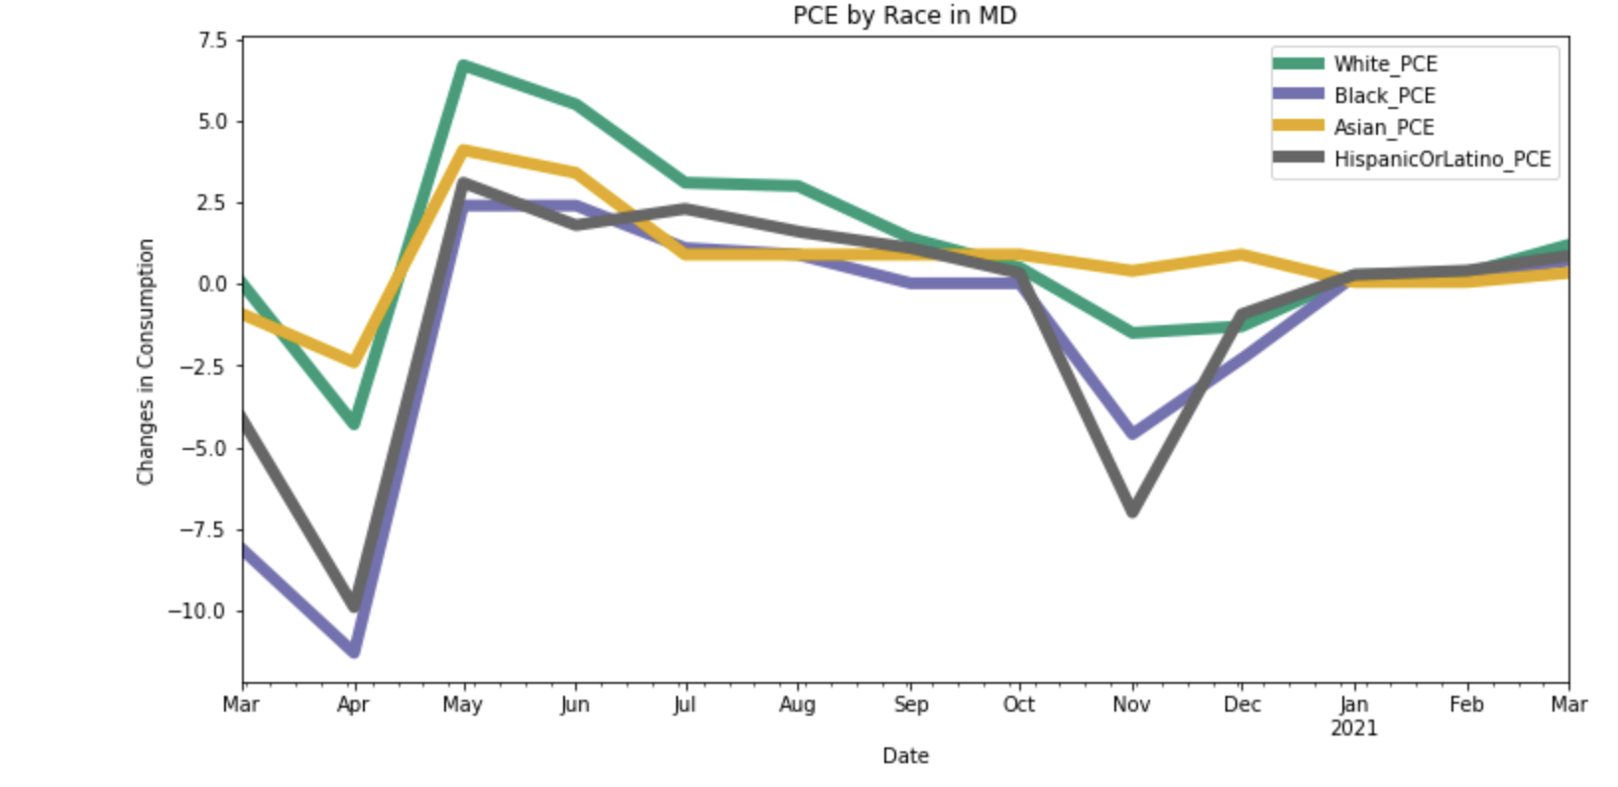
Personal Consumer Expenditures

Slide 8
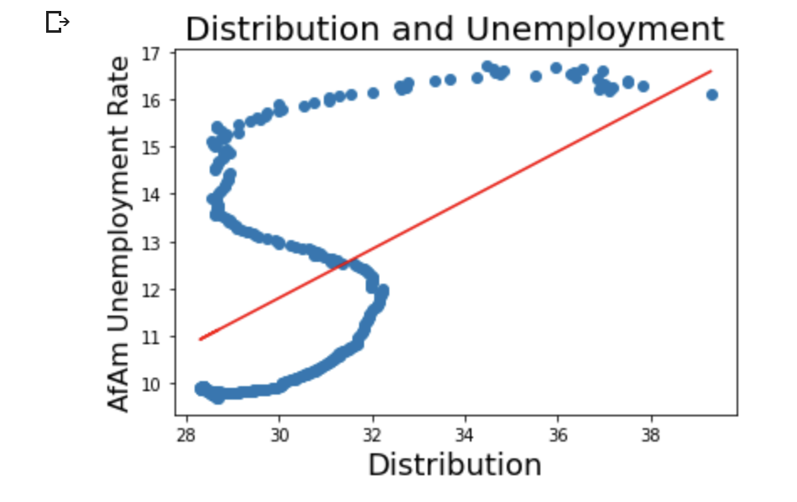
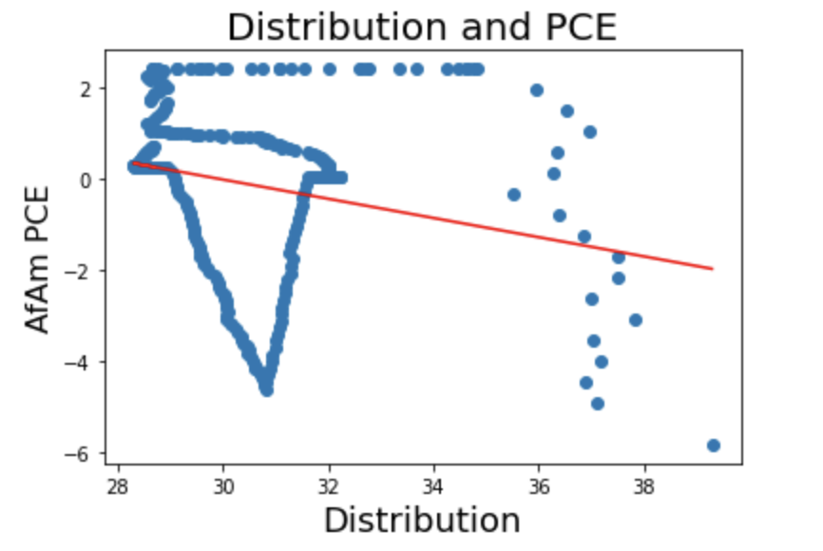
Regression Analysis

Slide 9
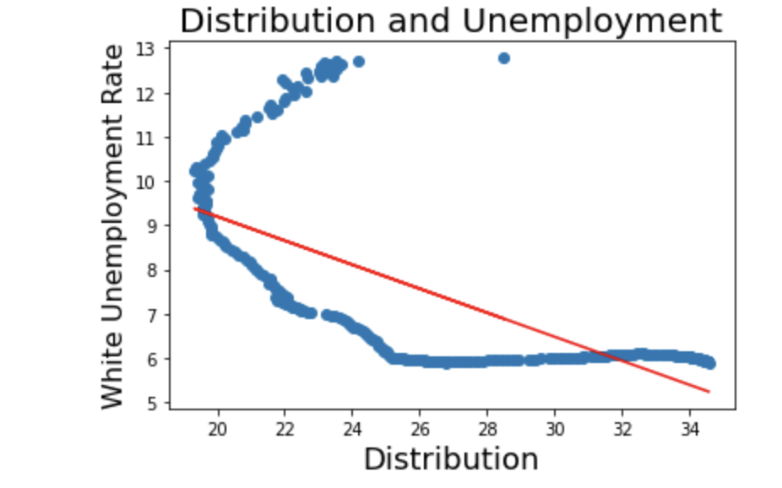
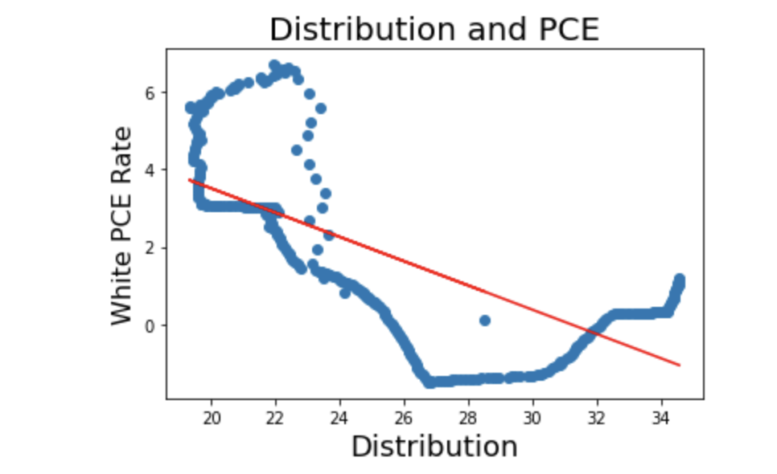
Regression Analysis

Slide 10
Next Steps
Adjust vaccination rates by race
Develop three machine learning models to forecast recovery.
Compare Results
Develop Final Conclusions

